Slide 1
Parent Workshop - SPaG
Mrs Nicholson

Slide 2
What is SPaG?
S – Spelling
P – Punctuation
a – and
G – Grammar
Grammar, punctuation and spelling are key areas in the teaching of English.

Slide 3
New Curriculum changes
The National Curriculum for English (from September 2014) placed a greater emphasis on vocabulary development, grammar, punctuation and spelling.
Expectations were raised significantly for each year group and pupils are expected to recognise and use the grammatical terminology appropriate to their year group.
Year 2 and Year 6 pupils are now tested on their SPAG knowledge as part of the national SATs tests.

Slide 4
SPAG test
Test Format in Year 6
The test is administered on paper with the spelling component administered orally by a test administrator. The total testing time is approximately 1 hour.
Component | Description of component | Timing
Component 1 | Grammar, Punctuation and Vocabulary | 45 mins
Component 2 | Spelling | Around 15 mins (not strictly timed)

Slide 5
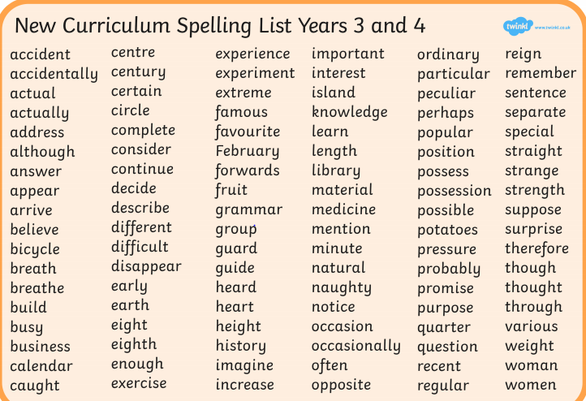
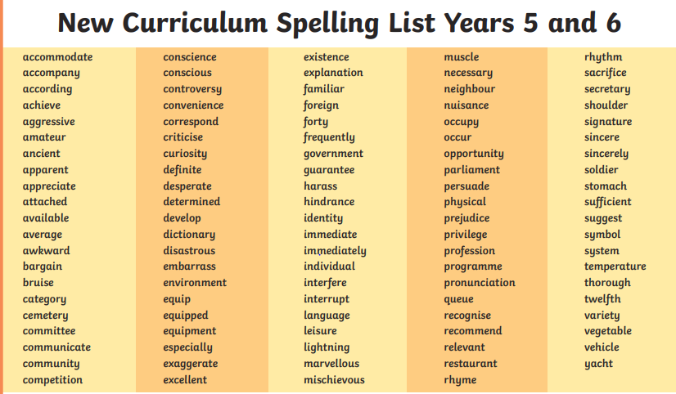
S is for Spelling
These lists are on our website.
Curriculum- English- Spelling
They are also made into spelling mats in every class for children to use.

Slide 6
Spelling at Carbeile
4 discrete spelling lessons a week
Lesson 1: explore word meanings, investigate root words, identify spelling patterns.
Lesson 2: identify the phonemes in that week’s words.
Lesson 3: practise spellings in fun ways/games
Lesson 4: low stake quiz.
Spellings are corrected using sound buttons.
Children correct with purple pen.

Slide 7
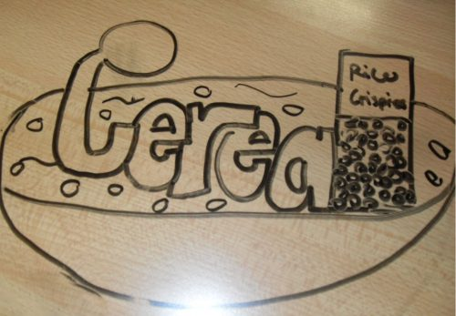
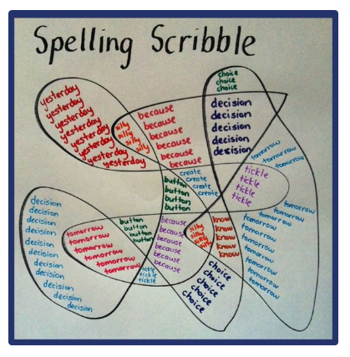
Example Games
Roll the dice
Spelling scribble
Graffiti
These games are on our website.
Curriculum- English- Spelling

Slide 8
P is for Punctuation
By the end of Y2
Finger spaces
Capital letters for names
Capital letters and full stops mark start and end of sentences
Questions marks ?
Exclamation marks !
Commas in lists
The large, grey and sad elephant
Apostrophes for contraction
e.g. can’t It’s I’m
Apostrophe for single possession
e.g. The girl’s name is Ann.
By the end of Y3
RECAP all Y2
Introduce use of speech marks for direct speech.
Known as “Inverted commas”

Slide 9
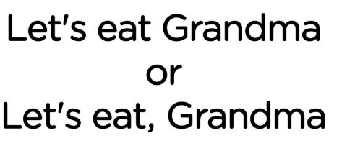
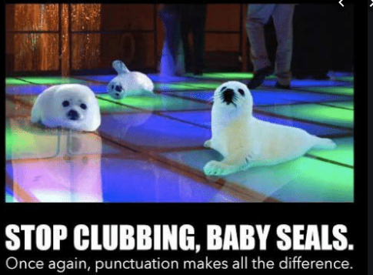
P is for Punctuation
By the end of Y4
Commas after fronted adverbials
e.g. After a while, Once upon a time,
Other punctuation within inverted commas for direct speech. Starts with a capital letter, comma after word for ‘said’ and punctuation inside final speech mark to end speech
e.g. Mark asked, “Please can I play?”
Apostrophe for plural possession
e.g. The girls’ team won the match.
By the end of Y5
Use of brackets () or dashes – - or commas , , to show parenthesis (extra information)
e.g.
The dog (called Rex) chased the cat.
The dog, who was called Rex, chased the cat.
The dog -who was called Rex- chased the cat.
Use of commas to avoid ambiguity.

Slide 10
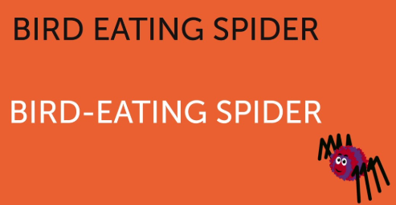
P is for Punctuation
By the end of Y6
Use of colons and semi-colons in longer lists
e.g. There the three suspects stood: Mrs White, the new housekeeper; Mr Green, the elderly gardener; and Miss Rose, the children’s governess.
Use of semi-colons to mark independent clauses linked in meaning.
e.g. The castle is very old; it has stood for centuries.
Use of colons to mark clauses that explains/ shows why.
e.g. My English teacher is wonderful: he makes punctuation easy and fun to learn
Use of Hyphens to avoid ambiguity.

Slide 11
Punctuation test examples

Slide 16
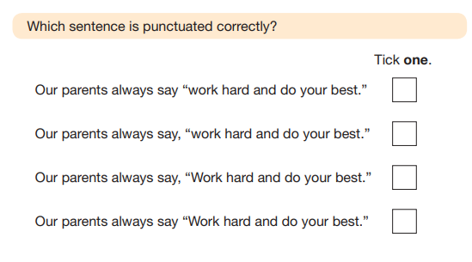

Slide 18
G is for Grammar
By the end of Y2
Nouns= objects, places and names
Adjectives= describe nouns (big, white, beautiful, scary)
Verbs= doing/being words (ran, eat, was, is)
Adverbs = tell us more about the verb (slowly, quietly)
*Coordinating conjunctions to link/join two sentences together
But Or And
*Subordinating conjunctions
Because, if, when, as, whilst, after, before, so, until
The difference between present and past tense.
He eats the cake / He ate the cake.

Slide 19
G is for Grammar
In KS2 we add these:
Pronouns which replace nouns (I, he, she, they, we, it)
Prepositions which show where or when something happened (on, at, under, over)
Determiners which come before a noun (a, an , the, some, most, one)
Fronted adverbials which start a sentence and tell us how, where, when or why (Cautiously, In the cave, At that moment, Because he was scared, )
Modal verbs which show degree of possibility (might, will, could, should)
Synonyms (words with same meaning) and Antonyms (words with opposite meaning)

Slide 20
G is for Grammar
In KS2: We revise and teach sentence types.
Statements = I like cake.
Commands= Get me some cake!
Questions= Do you like cake?
Exclamations= What a yummy cake!
Active and Passive sentences
The dog chewed the bone. Active because the subject is doing the action to the object.
The bone was chewed by the dog. Passive because the subject (bone) has something done to it.

Slide 21
Grammar test examples

Slide 26
Notes:
Commentary:
This question assesses the use of the passive voice. Passive and active voices were
previously assessed only in the Level 6 test. Pupils may omit the preposition phrase (agent) in their
answers. Recognisable misspellings are also accepted

Slide 28
How are we supporting pupils
PaG taught during our English Talk for Writing units.
Regular assessment of pupils in Termly GAPS tests
PaG total recall during lesson time
PaG always forms part of the WILF Success criteria in writing lessons
Y6- extra PaG lessons in afternoon and boosters

Slide 29
How can you help?
Educating yourselves on new curriculum via attending workshops or visiting our website
Practise spellings with your child (definitions too)
Encourage correct punctuation and grammar

Slide 30
Useful websites
BBC bitesize KS2 English
https://www.bbc.co.uk/bitesize/topics/zhrrd2p
Topmarks.co.uk/English games
https://www.topmarks.co.uk/english-games/7-11-years/spelling-and-grammar
Crickweb.co.uk/ks2literacy
http://www.crickweb.co.uk/ks2literacy.html
Woodlands literacy zone http://www.primaryhomeworkhelp.co.uk/literacy/

